Slide 1
${15}^{th}$ Bioinformatics in Health Sciences course
Introduction to R
Ana Gonçalves ICVS/3B’s, University of Minho
Nuno S. Osório ICVS/3B’s, University of Minho
February $7^{th}$ 2024
Notes:
Hello, I’m Margarida and today with the help of Nuno I will try to teach you R.
I hope you already have the R and Rstudio downloaded and also the files from OSF.
During this class we will shuffle between theory and coding, so any time you need to ask something do it, don’t worry. We will try to help you.

Slide 2
WHY LEARN R?
R is available for Windows, OS X, and Linux/Unix platforms.
R is free and open-source software, with no license restrictions.
R plays a key role in a wide variety of research and data analysis projects because it makes many modern statistical methods, both simple and advanced, readily available and easy to use.
R provides a wonderfully flexible programming environment favored by the many researchers who do some form of data analysis as part of their work.
Perhaps the most appealing feature of R is that any programmers can contribute code in the form of packages (or libraries), so the rest of the world has fast access to developments in statistics and data science.
Notes:
Point 2: One good thing about R is that it is constantly updated so you will always know when to update. When you open the R it will tell you with a warning.
Point 3 and Point 4: So, R is normally a recommended tool for researchers who need to do mainly statistical work and some plots with their data.
R is widely used in the areas of biology and medicine.
Point 5 : All the packages must have a detailed document, called vignette, where all the package functions are very detailed and explained. And they also must have a case study, or an example of how to use the these package.
They are very thoughtful and meticulous when accepting the packages to be used in R.

Slide 3


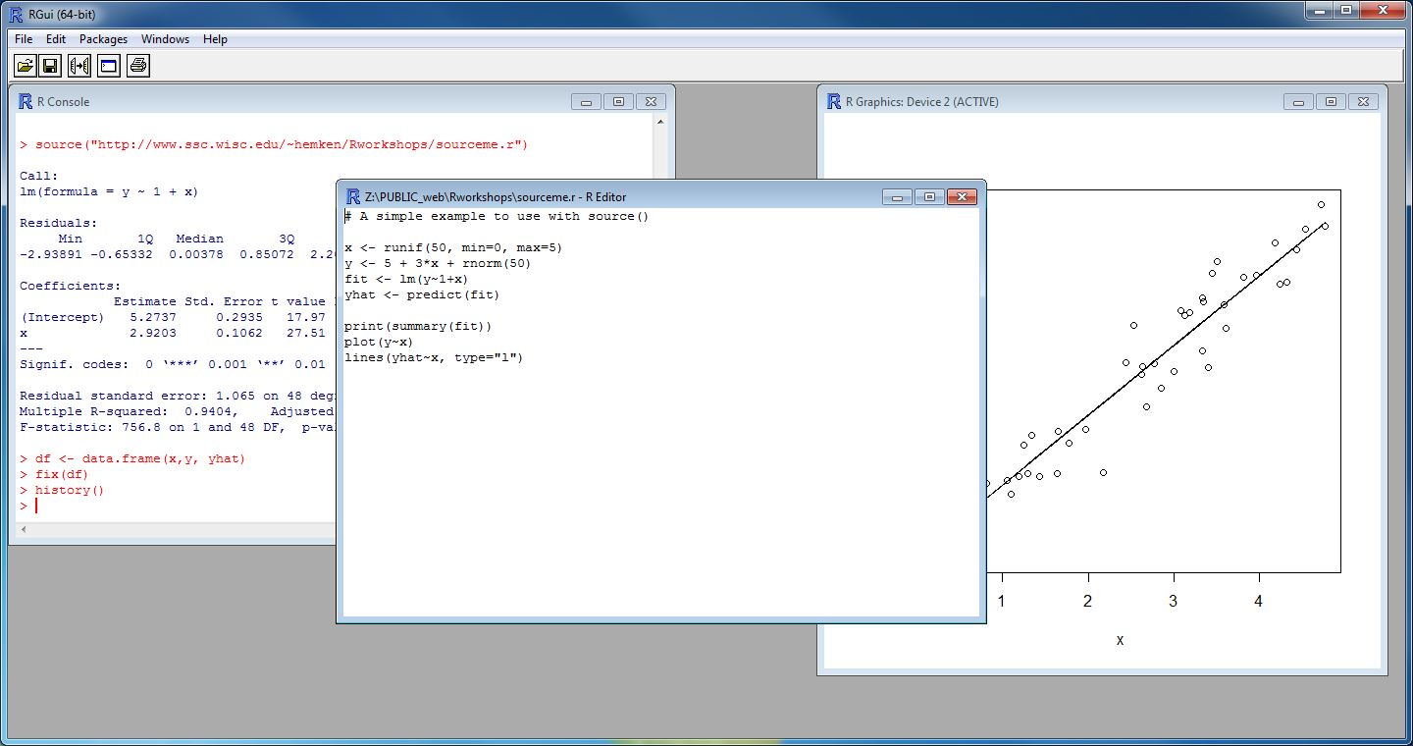
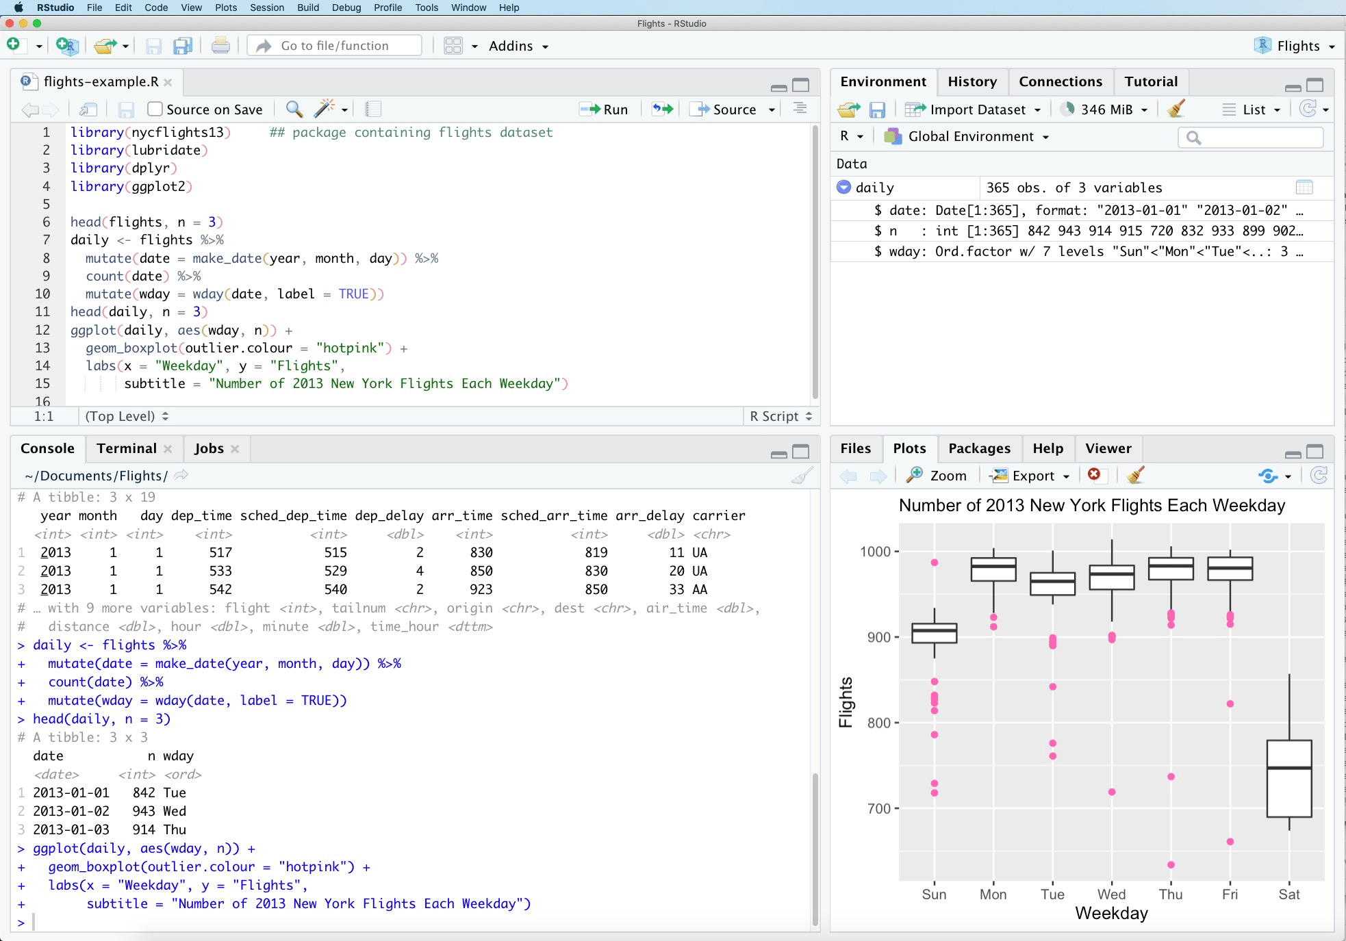
VS
R refers to a programming language as well as the software that runs R code.
RStudio is a software interface that can make it easier to write R scripts and interact with the R software.
Notes:
RStudio is a popular tool for implementing the R language and environment.
A characteristic that make RStudio particularly attractive is that
RStudio makes working in R easier

Slide 4
Time to do some coding!
Let’s go open both R and Rstudio to further understand the differences!
Sciences course${15}^{th}$ Bioinformatics in Health
Introduction to R
February $7^{th}$ 2024

Slide 5
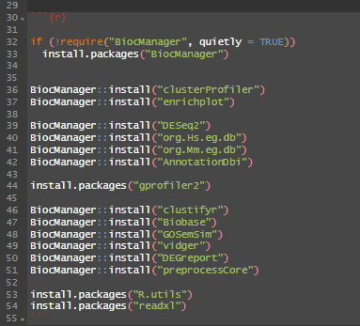
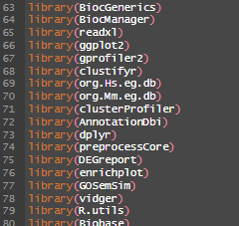
R: Packages
Packages are the fundamental units of reproducible R code. They include reusable R functions, the documentation that describes how to use them, and sample data.
Once a package is installed, we don’t need to install it
again in our R studio.
BUT…
We always need to call a library in order to run specific functions.
Notes:
nce you have installed a package, you use the library function to “check out” the package from your “library” of functions. To use the function, enter the exact name of the function without quotation marks

Slide 6

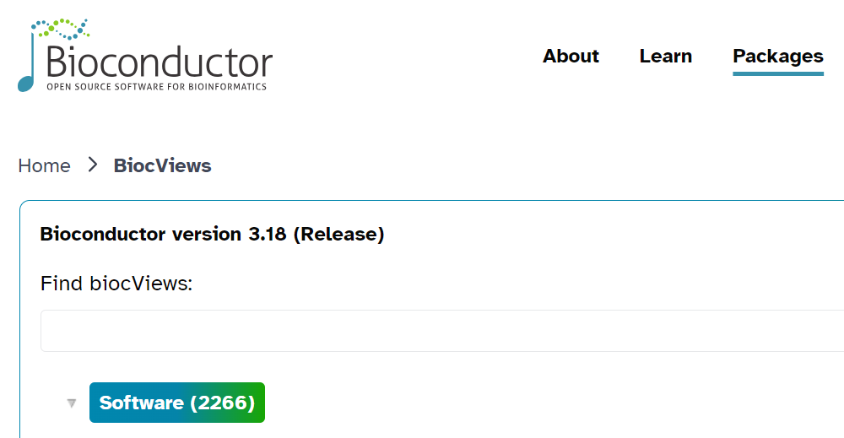
R: Packages - BiocManager
https://www.bioconductor.org/
https://www.bioconductor.org/packages/release/bioc/

Slide 7
R: files
To open a .txt file:
# Install utils package
install.packages(" utils ")
# Access utils package
library(utils)
Now, depending if the txt file has decimals, a header, and other factors, three functions can be selected:
# Read data from .xlsx sheet called "Year1" as data frame and assign to object
1. Data <- read.delim(file = "my_file.txt", header = TRUE, sep = "t", dec = ".")
2. Data <- read.delim2(file = "my_file.txt", header = TRUE, sep = "t", dec = ",")
3. Data <- read.table(file = "my_file.txt", header = TRUE)

Slide 8
R: files
To open a CSV file:
# Install readr package
install.packages("readr")
# Access readr package
library(readr)
# Read .csv file into R as data frame
Data <- read_csv(“transcriptomics.csv")
# Read .csv data file into R from a website
data <- read_csv("https://raw.githubusercontent.com/tutorial/transcriptomics.csv ")
We will use this method in our script

Slide 9
R: files
To open a .xlsx file:
# Install readxl package
install.packages("readxl")
# Access readxl package
library(readxl)
# Read data from .xlsx sheet called “transcriptomics" as data frame and assign to object
Data <- read_excel(“data.xlsx", sheet=“transcriptomics")

Slide 10
Time to do some coding!
Sciences course${15}^{th}$ Bioinformatics in Health
Introduction to R
February $7^{th}$ 2024

Slide 11
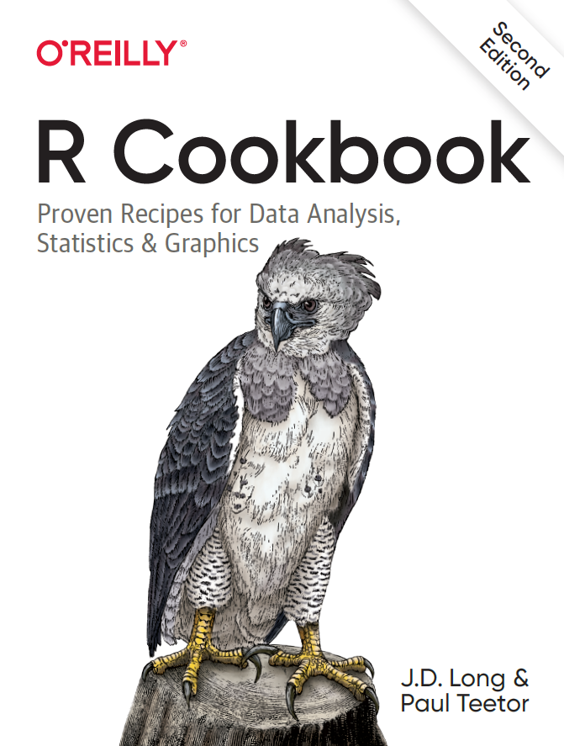
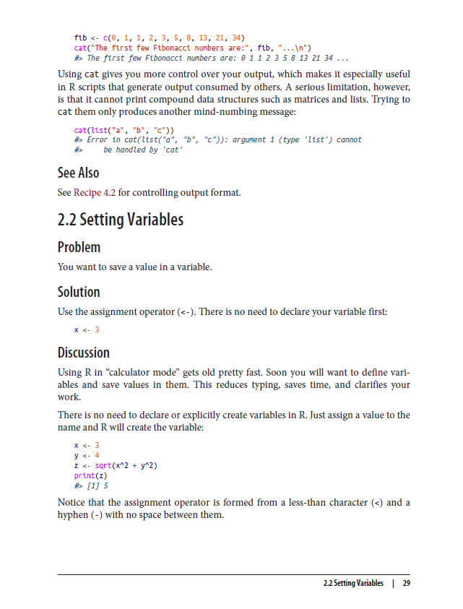
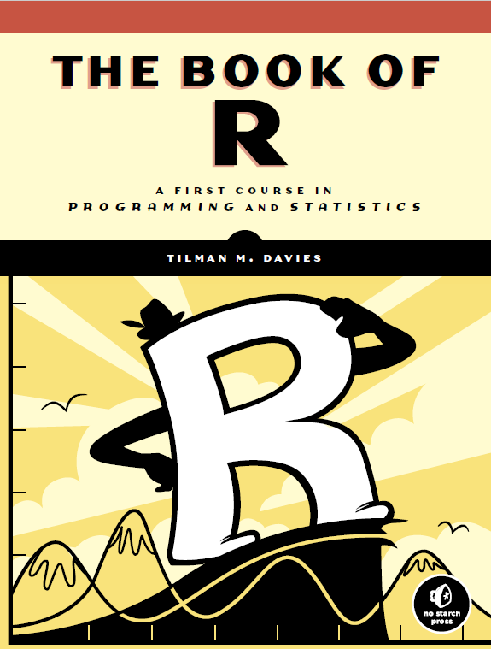
R: Books recommendations

Slide 12
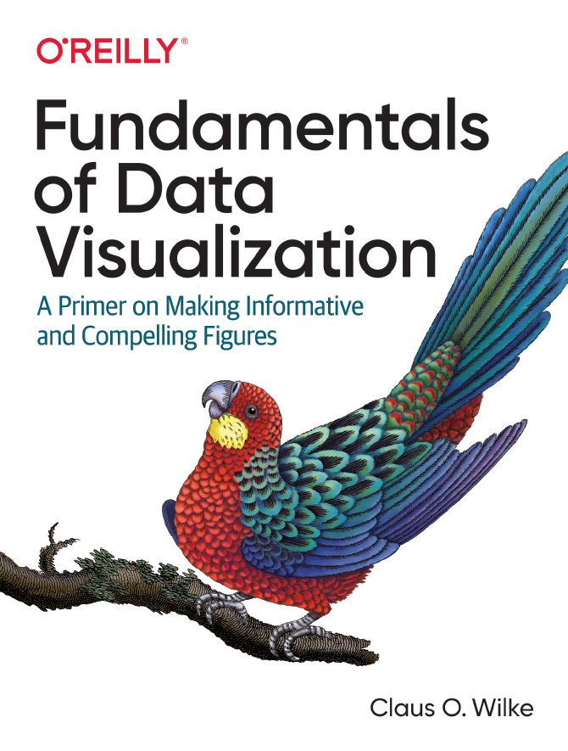
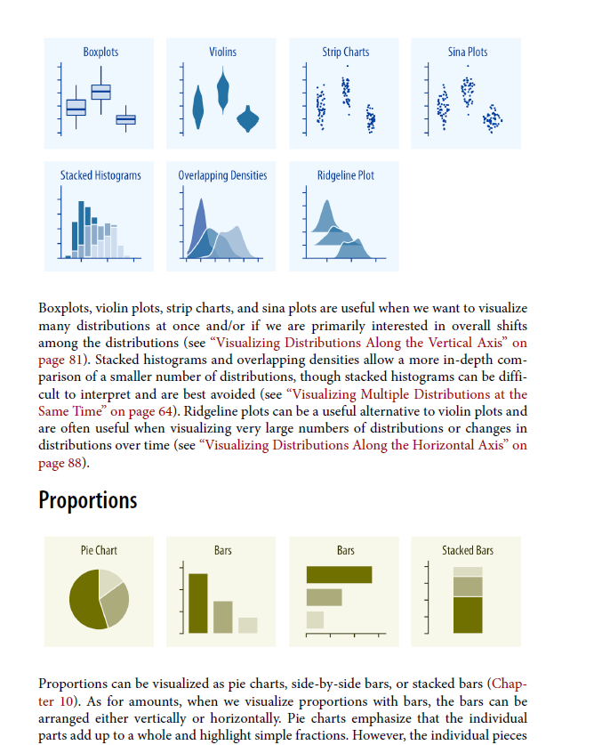
R: Books recommendations

Slide 13
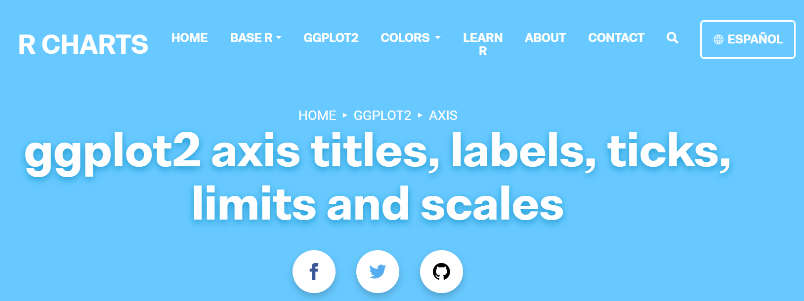
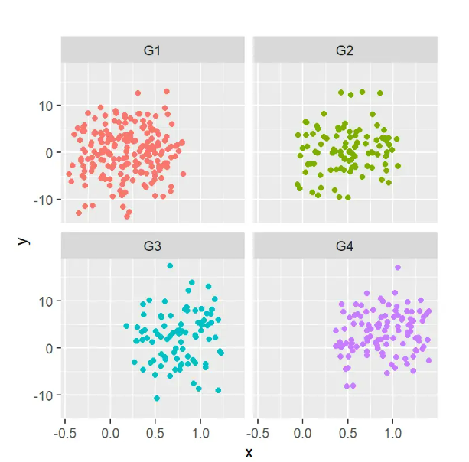
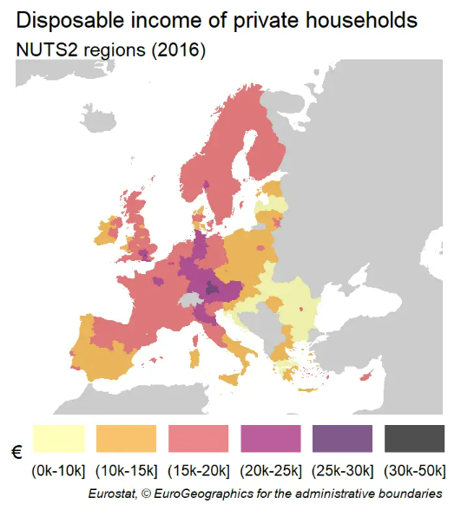
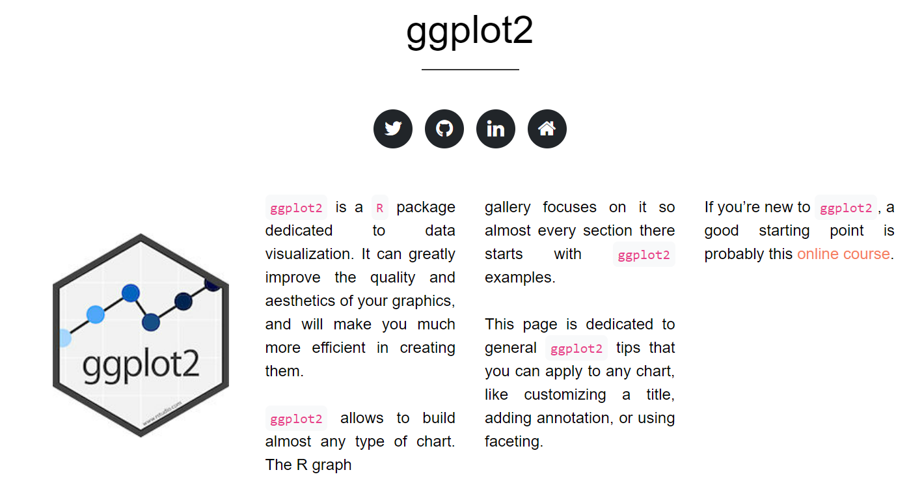
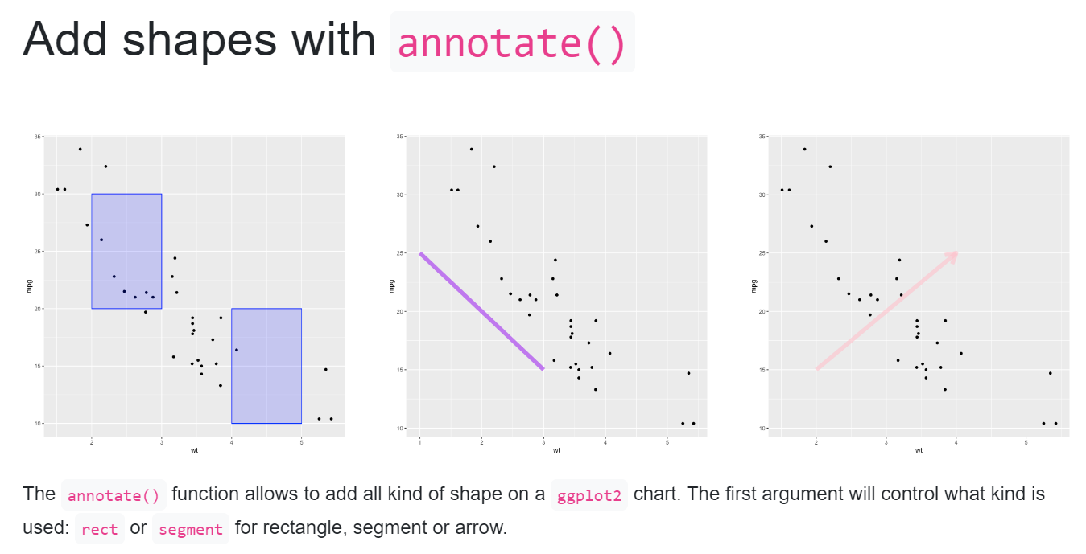
R: ggplot2 Package
https://cran.r-project.org/web/packages/ggplot2/index.html
https://r-charts.com/ggplot2/
https://r-graph-gallery.com/ggplot2-package.html

Slide 14
Time to do some coding!
Sciences course${15}^{th}$ Bioinformatics in Health
Introduction to R
February $7^{th}$ 2024

Slide 15
${15}^{th}$ Bioinformatics in Health Sciences course
Using R for Gene Expression Analysis
Ana Gonçalves ICVS/3B’s, University of Minho
Nuno S. Osório ICVS/3B’s, University of Minho
February $7^{th}$ 2024

Slide 16
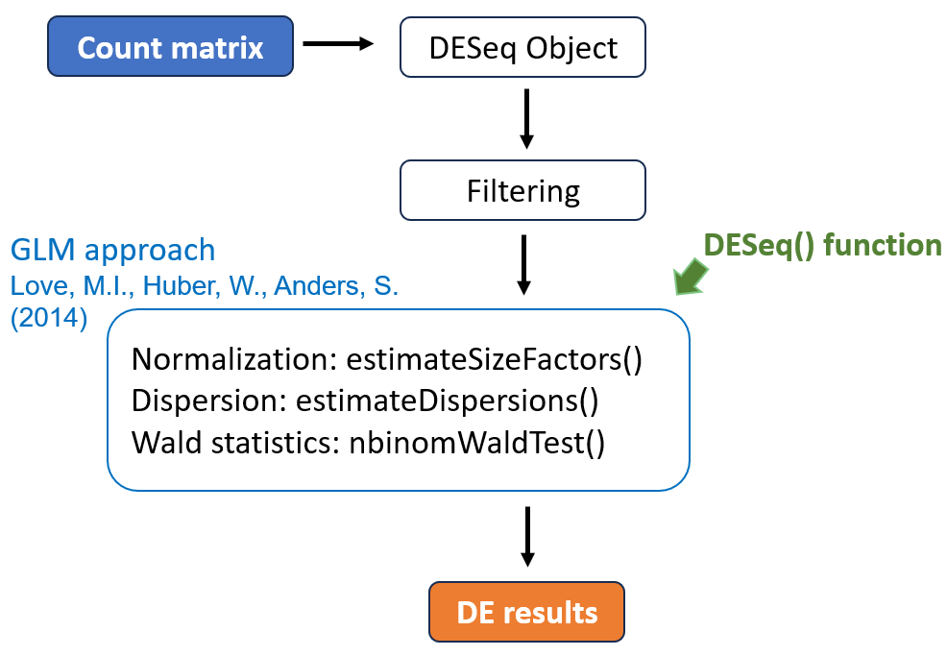
R: Package for DE genes analysis
DESeq2: A Popular RNA-Seq Analysis Package
Widely used and well-documented: DESeq2 is a widely used tool in the bioinformatics community, with a large user base and a well-documented user manual.
https://bioconductor.org/packages/devel/bioc/vignettes/DESeq2/inst/doc/DESeq2.html
Workflow
An object used to store the input values, intermediate calculations and results of the analysis of differential expression.
The reads from the
RNA sequencing
experiment
Removal of genes that have null reads across all samples
Acquire the differential expressed genes

Slide 17
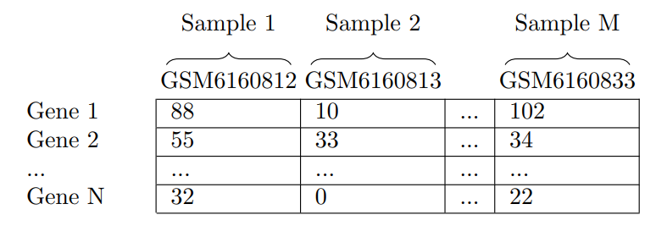

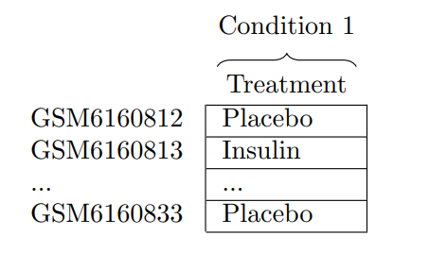
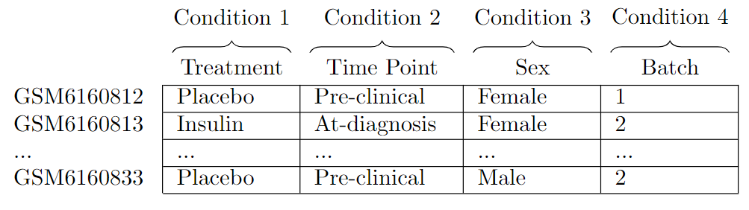
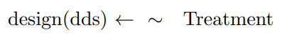
R: Information necessary for the DESeq Object
Count Matrix
Study information
Study design

Slide 18
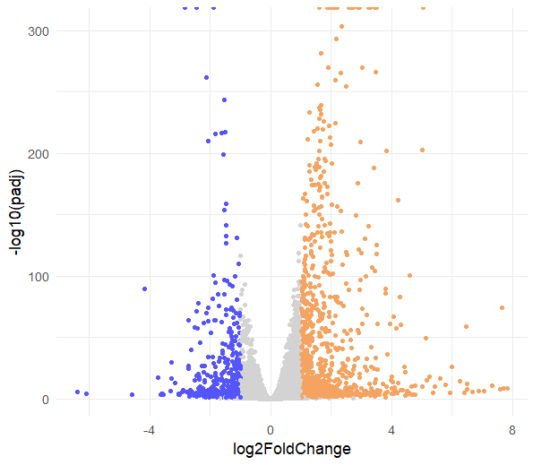
R: DE results
Volcano Plot
Each dot represents a gene;
Most statistically significant genes will be towards the top;
Most upregulated genes will be towards the right;
Most downregulated genes are towards the left;
Fold change equal to 0 means that the expression does not change.

Slide 19
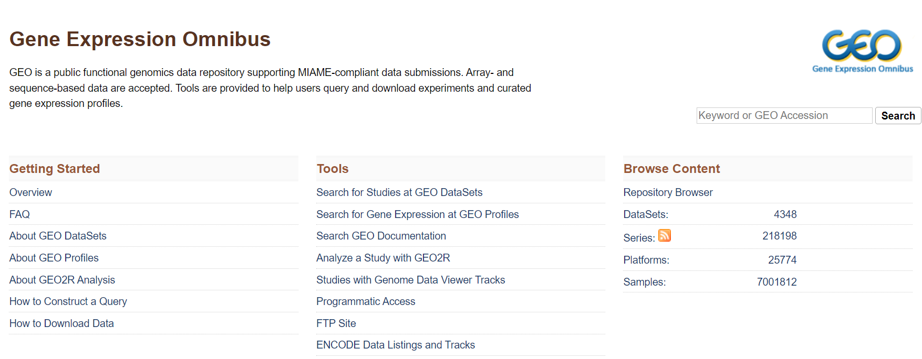
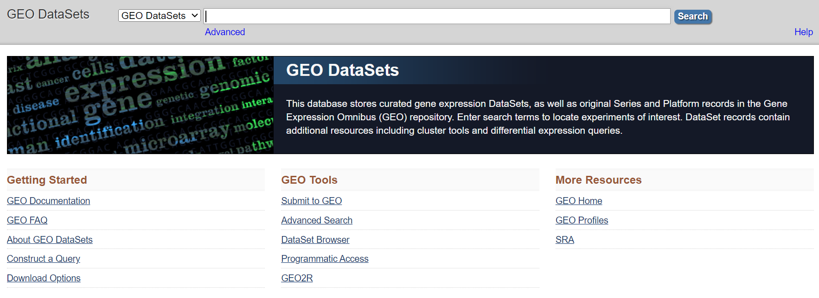
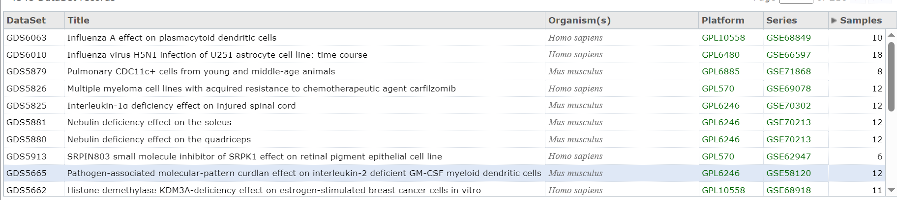
R: DESeq2
Let's get a count matrix from an RNA sequencing experiment from the National Center for Biotechnology Information repository!
Dataset: https://www.ncbi.nlm.nih.gov/geo/query/acc.cgi?acc=GSE232750
Home - GEO - NCBI (nih.gov)

Slide 20
Time to do some coding!
Let’s go back to the R visualization script
Sciences course${15}^{th}$ Bioinformatics in Health
Introduction to R
February $7^{th}$ 2024

